Slide 1
CEGE0096: Geospatial Programming
Lecture 3: Python Data Structures, IDE and Debugger
Dr. Aldo Lipani

Slide 2
Python III

Slide 3
Our Python (Imperative) Journey
Types
Operators
Variables
Simple I/O
Branching
Loops
Functions
Program Planning
Tuples
Lists
Sets
Dictionaries
Strings
Files
Covered in the 1st Lecture
Covered in the 2nd Lecture

Slide 4
Review Exercise 3
Write a program that keeps requesting the user to input a temperature in degrees Celsius and prints out a suitable message according to the temperature state below:
“Freezing” when the temperature is below zero;
“Very cold” when it’s between 0 and 10 (not included);
“Cold” when it’s between 10 and 20 (not included);
“Normal” when it’s between 20 and 30 (not included);
“Hot” when it’s between 30 and 40 (not included);
“Very hot” when it’s above 40.
The program should stop when the user enters a number greater or equal to 100.
You are allowed to use variables, operators, if statements and loops.
Function reminder:
input('message') prints the message and waits for the user for an input
float to convert strings to floating-point numbers
Notes:
3

Slide 5
Solution
print('Temperature to Perceived Temperature Converter (0.2)') temp = input('What temperature is outside?') temp = float(temp) while temp < 100: perceived_temp = '' if temp < 0: perceived_temp = 'freezing' elif temp < 10: perceived_temp = 'very cold' elif temp < 20: perceived_temp = 'cold' elif temp < 30: perceived_temp = 'normal' elif temp < 40: perceived_temp = 'hot' else: perceived_temp = 'very hot' print('Your temperature today is', perceived_temp) temp = input('What temperature is outside?') temp = float(temp) print('Huuu, with such heat I better shut myself down!')
Changes with respect to the solution of Exercise 1 are in bold!
Notes:
4

Slide 6
Review Exercise 4
Write a program that asks the user for 3 angles in degrees and checks, if possible, which triangle you can build with them:
Equilateral triangles have all angles equal;
Isosceles triangles have 2 equal angles;
Scalene triangles have all of them are different.
This check should be done in a function. The function should return the type of triangle.
Rules are the same as the previous exercise.
Notes:
5

Slide 7
Solution
def get_triangle_type(angle_1, angle_2, angle_3):
res = 'scalene' if angle_1 + angle_2 + angle_3 != 180: res = 'none' elif angle_1 == angle2 and angle_2 == angle_3: res = 'equilateral' elif angle_1 == angle2 or angle_2 == angle_3 or angle_3 == angle_1: res = 'isosceles' return res print('Angles Checkers for Triangles (1.1)') angle_1 = float(input('1st angle: ')) angle_2 = float(input('2nd angle: ')) angle_3 = float(input('3rd angle: ')) triangle_type = get_triangle_type(angle_1, angle_2, angle_3) if triangle_type == 'none': print("You can't build a triangle out of these angles!!!") else: print('You can build an', triangle_type, 'triangle')
Notes:
6

Slide 8
So far
Can you write a program that averages a series of user inputs? Yes!
n = int(input('How many values?')) num = 0 for i in range(n): v = float(input('Value number ' + str(n) + ': ')) num = num + v print('The average is:', num / n)
Can you compute this average again without the 2nd element?
Umh!

Slide 9
Data Structures
In Python, there are 4 data structures:
Lists
Tuples
Sets
Dictionaries
These should be used based on your needs. Usually also to maximise the overall speed of your program in performing these operations:
Access: Reading an element stored in a specific location of the data structure
Search: Finding a specific element within the data structure
Insert: Adding a new element to the data structure
Delete: Delete an element from the data structure

Slide 10
Tuples ()
Tuples are immutable sequences of objects.
You declare them by using () and separating the objects by commas.
empty_tuple = () another_tuple = (1, 2, 3, 'hello')
To know the length of a tuple, you can use len.
You have already seen them when returning more than one value in functions:
return (a, b)
You can access the elements using the slicing operators (like strings):
print(tuple[2:4]) print(tuple[1]) print(tuple[-1:-3:-1])

Slide 11
Lists []
Lists are like tuples, but they are mutable.
empty_list = [] another_list = [1, 2, 3, 'hello']
To know the length of a list you can use len.
You can access lists values like for the tuples using the slicing operators.
You can change the values of lists like:
another_list[2] = 5
Warning: make sure you have more than 2 values in the list, or list index out of range error.

Slide 12
Lists [] (II)
You can append a value to a list:
a_list.append('world')
You can insert a new value before a given value:
a_list.insert(0, 'hello')
You can remove (and return) an item from the list at a given index (if no index is specified the last element will be removed):
a_list.pop(3)
And many more.

Slide 13
Sets {} (set() if empty)
A set is an unordered collection of objects with no duplicates.
empty_set = set() another_set = {'apples', 'oranges'}
To know the length of a set you can use len.
Like lists, sets are mutable. You can add, remove (discard), or pop an element. The pop is done on an arbitrary element.
To check if an element belongs to a set you can use the in operator:
'pears' in another_set
Where have we seen the in operator before?

Slide 14
Sets {} (II)
Between two sets you can perform sets operations.
Union between two sets:
set1.union(set2)
Intersection between two sets:
set1.intersection(set2)
Difference between two sets:
set1.difference(set2)
And many more.

Slide 15
Dictionaries {}
Dictionaries are mutable and unordered collections of key-value pairs. Like an actual dictionary you have for each word (keys) a definition (values).
empty_dictionary = {} another_dictionary = {'apples':10, 'oranges':2}
To know the length of a dictionary you can use len.
You can access an element like:
another_dictionary['apples']
You can add or update an existing key:
another_dictionary['pears'] = 0

Slide 16
Dictionaries {} (II)
You can access the set of keys or values via the keys() and values() methods:
another_dictionary.keys() another_dictionary.values()
To check if a key belongs to a dictionary you can use the in operator:
'pears' in another_dictionary

Slide 17
For Loops and Data Structures
You can iterate across a data structure using loops. This will print in order the objects contained in tuple_or_list:
for value in tuple_or_list: print(value)
This will print the keys (or objects for sets) contained in a set_or_dictionary (no order is guaranteed):
for value in set_or_dictionary: print(value)
For dictionaries, use items() if you need to iterate across keys and values at the same time:
for key, value in dictionary.items(): print(key, value)

Slide 18
Strings (II)
It turns out that strings behave similarly to lists.
You can iterate across the characters of a string like:
string = 'hello' n = len(string) for i in range(n): print(string[i])
string = 'hello' for c in string: print(c)

Slide 19
String Manipulation
You can split a string based on a given character:
string = 'hello,world!' string.split(',') # ['hello', 'world!']
You can remove white spaces around a string using strip:
string = ' world! ' string.strip() # 'world!'
You can replace substrings of a string using replace:
string = 'hello,world!' print(string.replace('e', 'o')) # 'hollo,world!'

Slide 20
Performance of Data Structures
Access an element by index;
Search an element by value;
Insert an element in the data structure;
Delete an element from the data structure.
 | Access | Search | Insert | Deletion
Tuples | Fast | Slow | N/A | N/A
Lists | Fast | Slow | Slow | Slow
Sets | N/A | Fast | Fast | Fast
Dictionaries | N/A | Fast | Fast | Fast

Slide 21
Which Data Structure
Which data structure would you use if you need…
…to keep the order of a sequence of values inputted by the user?
…to check whether a sequence of values inputted by the user contains duplicates?
…to count how many times an item is inputted by the user?
…to return two values from a function?
…to compute the average of a sequence of values once?
list
set
dictionary
tuple
a variable :P

Slide 22
Files
You can open a file with the built-in function open.
Open takes two parameters, file_name (with path) and mode:
Use mode 'w' (for write) to write the file like this:
string = 'Hello, World!' with open('file_name', 'w') as f: f.write(string)
Use mode 'r' (for read) to read the file like this:
with open('file_name', 'r') as f: print(f.readline())
If you open a file using with you don’t need to do anything else (like closing the file or handling exceptions).

Slide 23
Exercise 5 (30 Minutes)
Given a sequence of numbers inputted by the user, compute the following statistics:
min,
max,
average,
number of duplicates and
mode.
You should define a function for each one of these statistics.
TIP: these functions should take as input a sequence of numbers.
Notes:
22

Slide 24
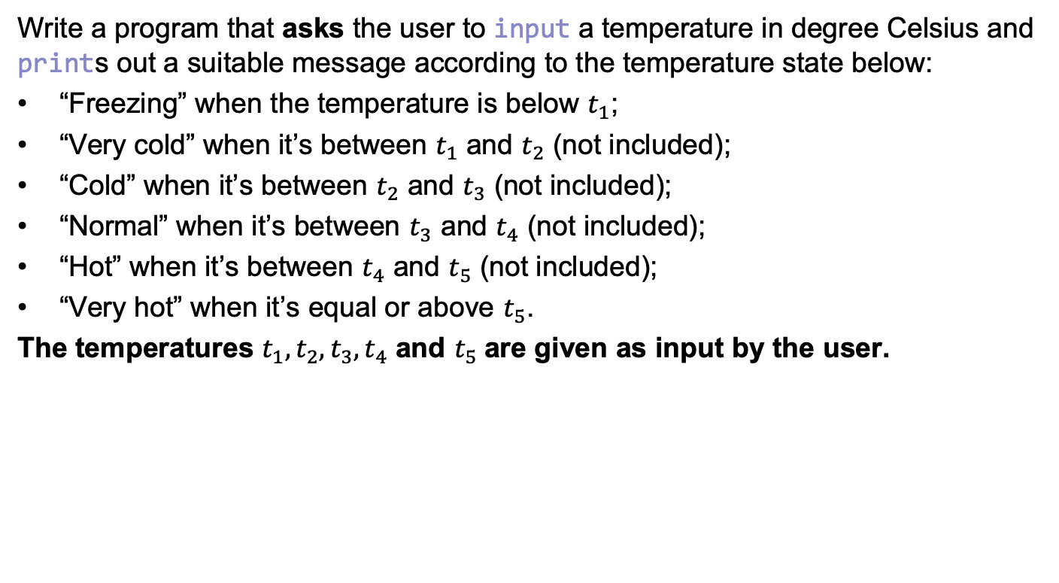
Exercise 6 (10 Minutes)
Write a program that asks the user to input a temperature in degree Celsius and prints out a suitable message according to the temperature state below:
“Freezing” when the temperature is below $t_{1}$;
“Very cold” when it’s between $t_{1}$ and $t_{2}$ (not included);
“Cold” when it’s between $t_{2}$ and $t_{3}$ (not included);
“Normal” when it’s between $t_{3}$ and $t_{4}$ (not included);
“Hot” when it’s between $t_{4}$ and $t_{5}$ (not included);
“Very hot” when it’s equal or above $t_{5}$.
The temperatures $t_{1}, t_{2},t_{3},t_{4}$ and $t_{5}$are given as input by the user.
Notes:
23

Slide 25
IDE and Debugger

Slide 26
Anaconda
Python is an open-source programming language. Python is free to download from the Python Software Foundation.
Other organisations provide Python. For example, the Environmental Systems Research Institute (Esri) distributes a version of Python compatible with ArcGIS.
Continuum Analytics distributes Python (and R) with a bundle of data science libraries branded as Anaconda. Their business model is to sell support services to organisations that require operational reliability and security.
The Anaconda distribution system is installed with a package manager called conda and a GUI front-end called Anaconda Navigator.
Installing packages using conda provides a platform-neutral solution and avoids many hours of hassle.

Slide 27
Anaconda (II)
You can define environments like the geospatial one.
A conda environment is a directory that contains a specific version of Python and a collection of packages that you have installed.
Environments are independent: If you change one environment, the other environments are unaffected.
You can easily activate or deactivate environments, which is how you switch between them.
You can also share your environment with someone by giving them a copy of your environment.yaml file.

Slide 28
Jupyter Notebook
Jupyter is an application that runs a Python kernel and provides input/output to that kernel via a local webserver.
The input/output is viewed using your favourite browser.
Jupyter provides a web app to create and edit .ipynb notebook files.
These files combine markdown text and Python code.
Jupyter notebooks are used for:
Developing small projects
Documenting a workflow
Providing training resources

Slide 29
Debugger
A debugger is a computer program used to test programs and search for and eliminate errors in programs (aka bugs).
A debugger offers a thorough understanding of the workflow of a program by providing the following:
A step-by-step execution;
A complete view of all the variables defined in the program;
The ability to set breakpoints.
The most notable Python debugger is pdb. This is used like a library and coded in your program. It is flexible because it can be used in any Python program. However, it’s not the most user-friendly debugger.
pdb will not be covered in this module.

Slide 30
Integrated Development Environment (IDE)
An IDE is a software application that provides comprehensive facilities to computer programmers for software development.
They tend to be language-specific. An IDE can be the best for one language but not as good for another.
They include all you need to create a program in a given programming language, including a source code editor, build automation tools, and a debugger.
The boundary between an IDE and other parts of the broader software development environment is not well-defined; sometimes, a version control system or various tools to simplify the construction of a graphical user interface (GUI) are integrated.
Some IDEs allow the installation of third-party plug-ins to further extend their functionalities.
There are many IDEs for Python.

Slide 31
PyCharm (IDE)
PyCharm Community edition is a free, open-source IDE with a
smart Python editor.
PyCharm provides quick code navigation, code completion, refactoring, unit testing and debugger.
The professional edition fully supports Web development with Django, Flask, Mako and Web2Py and allows remote development.
JetBrains offers free PyCharm professional licenses for Student/Educational use.
https://www.jetbrains.com/community/education/#students

Slide 32
PyCharm Ecosystem
PEP8

Slide 33
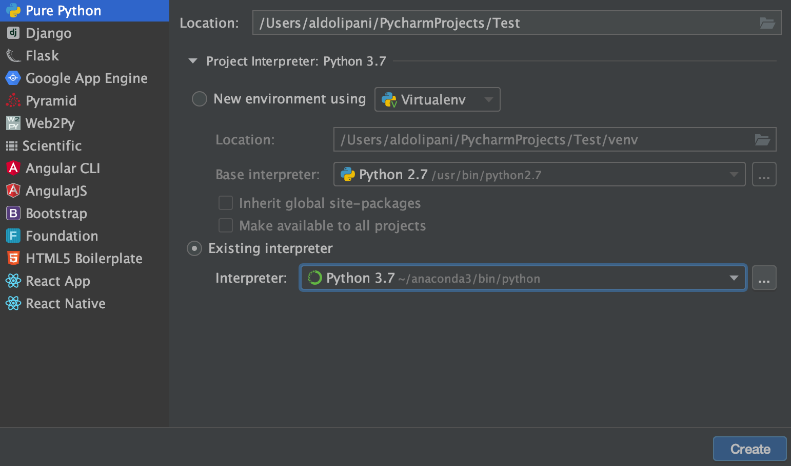
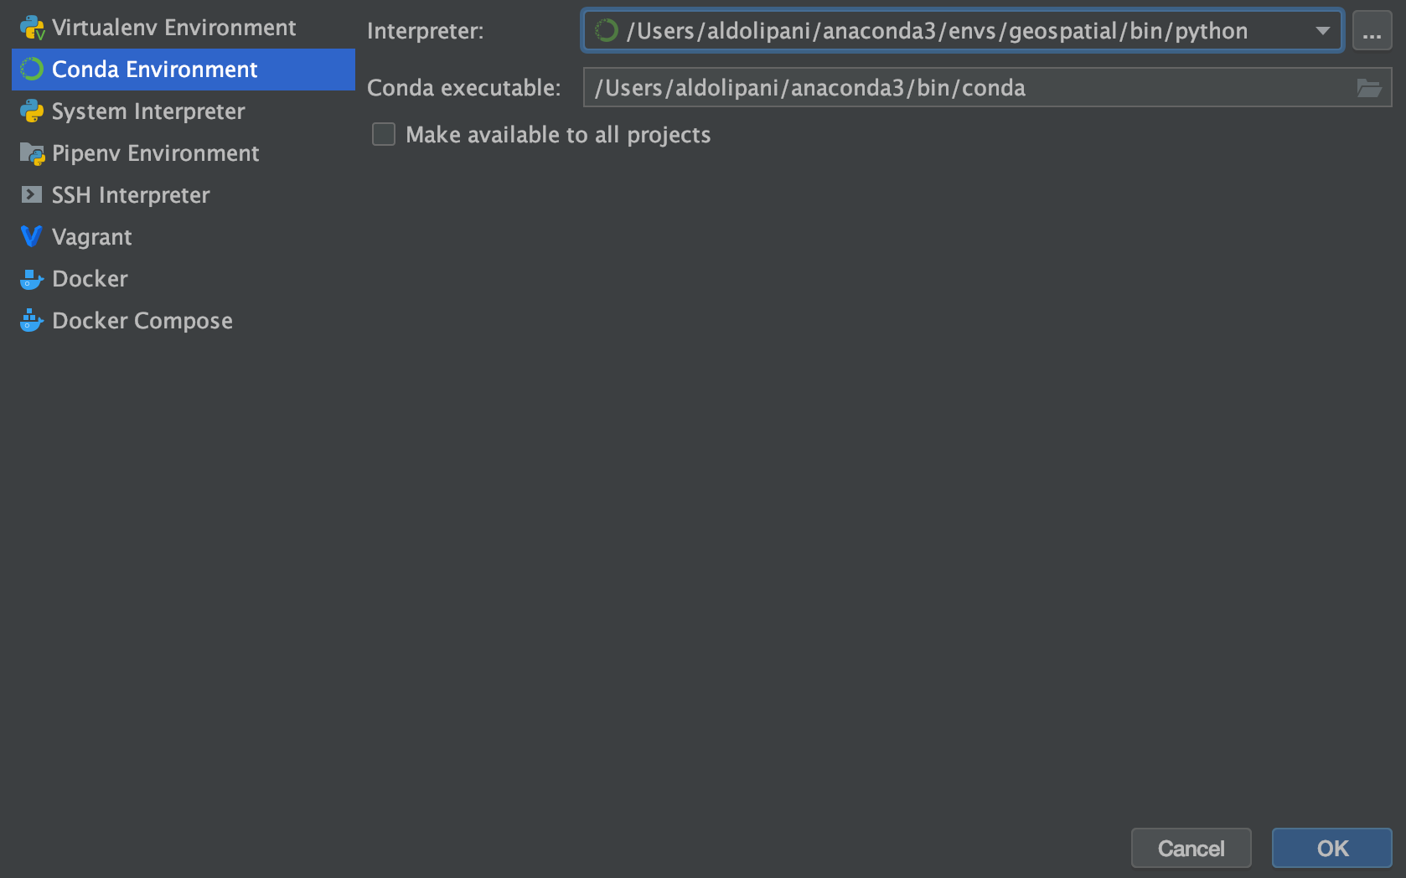
PyCharm
File ⇲ New Project
Name and Location of the Project
Python Interpreter
If the Anaconda geospatial env is not available, click here to select it.

Slide 34
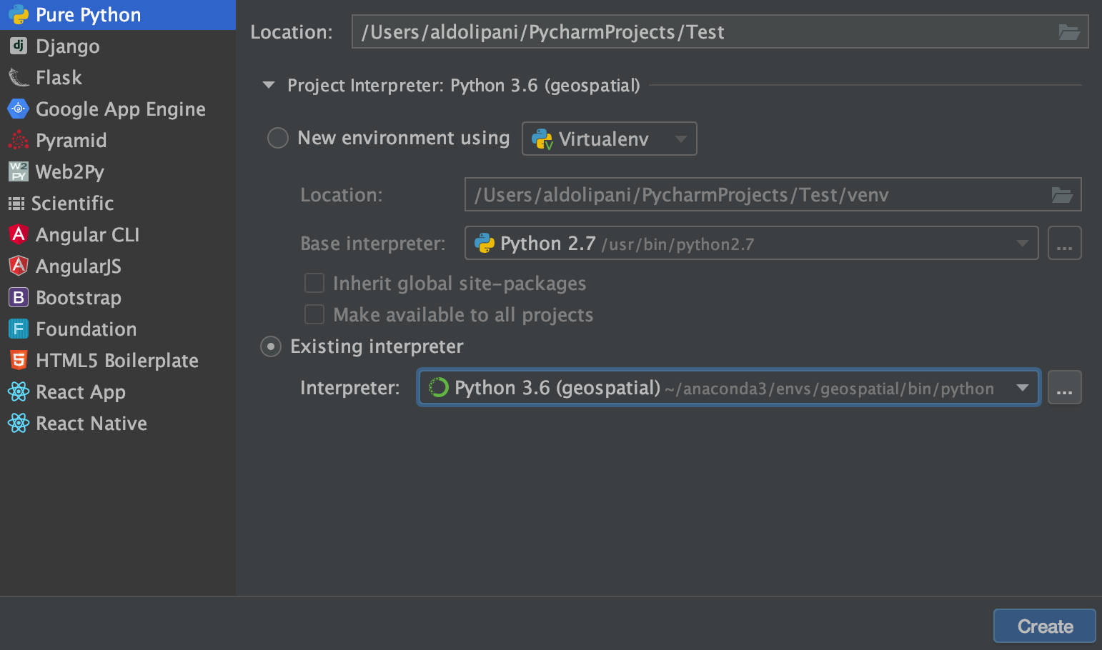
PyCharm
File ⇲ New Project
Name and Location of the Project
Anaconda Integration

Slide 35
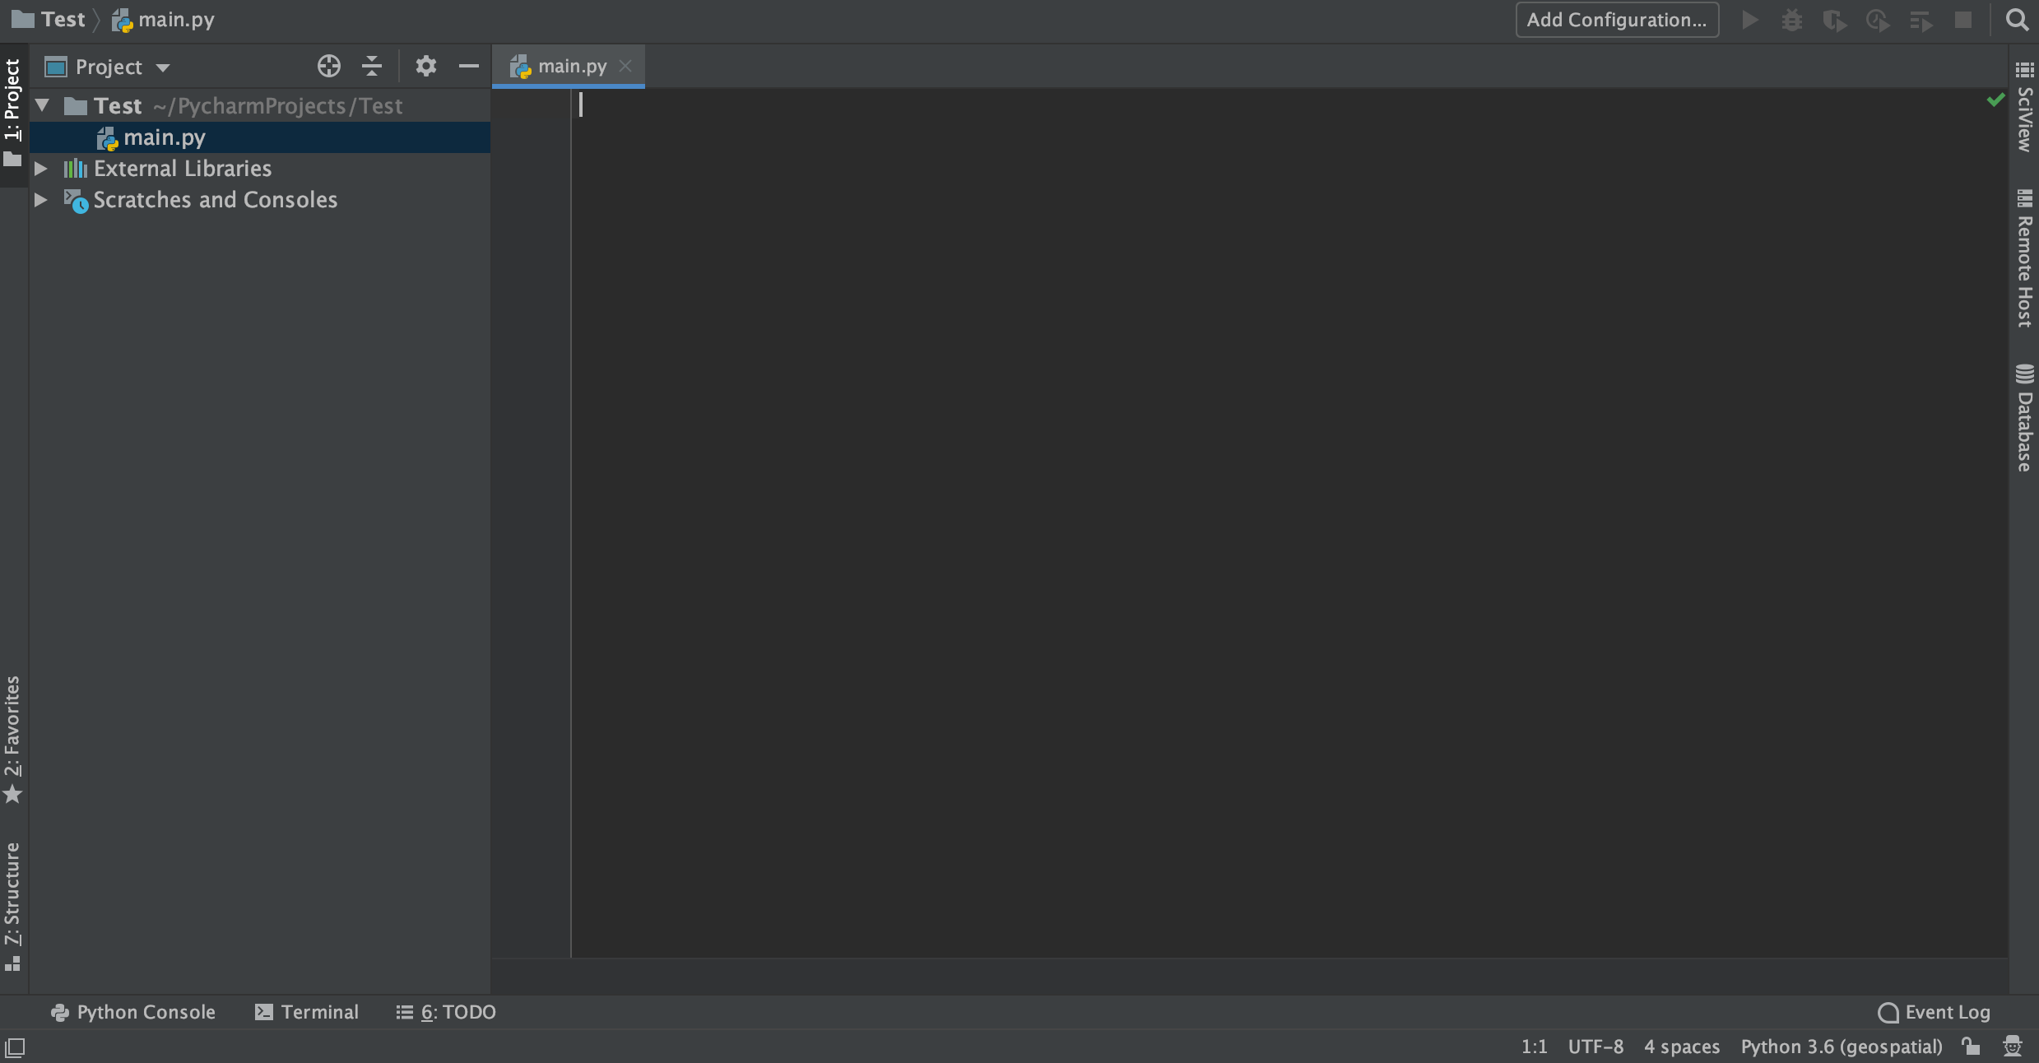
PyCharm
After having created a file main.py…
VCS Support
To Configure
Project Structure
Anaconda Interpreter

Slide 36
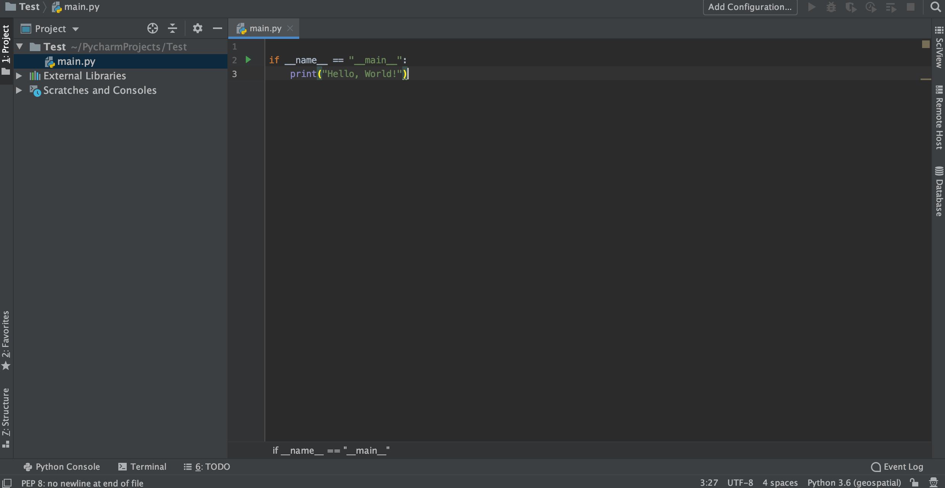
PyCharm
After writing an if __name__ == "__main__": a green play sign appears.

Slide 37
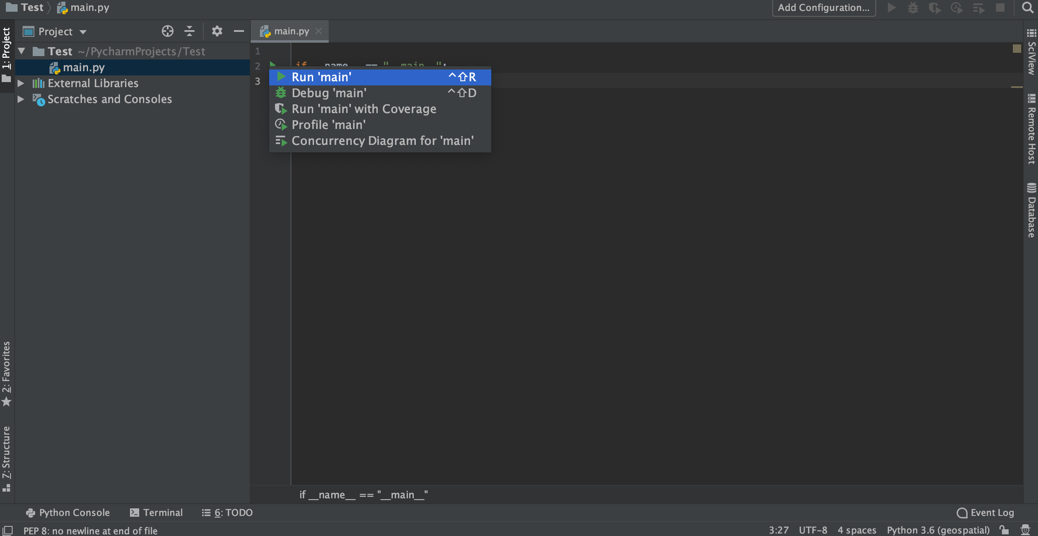
PyCharm
It will ask if you want to run the main file (Click on it).

Slide 38
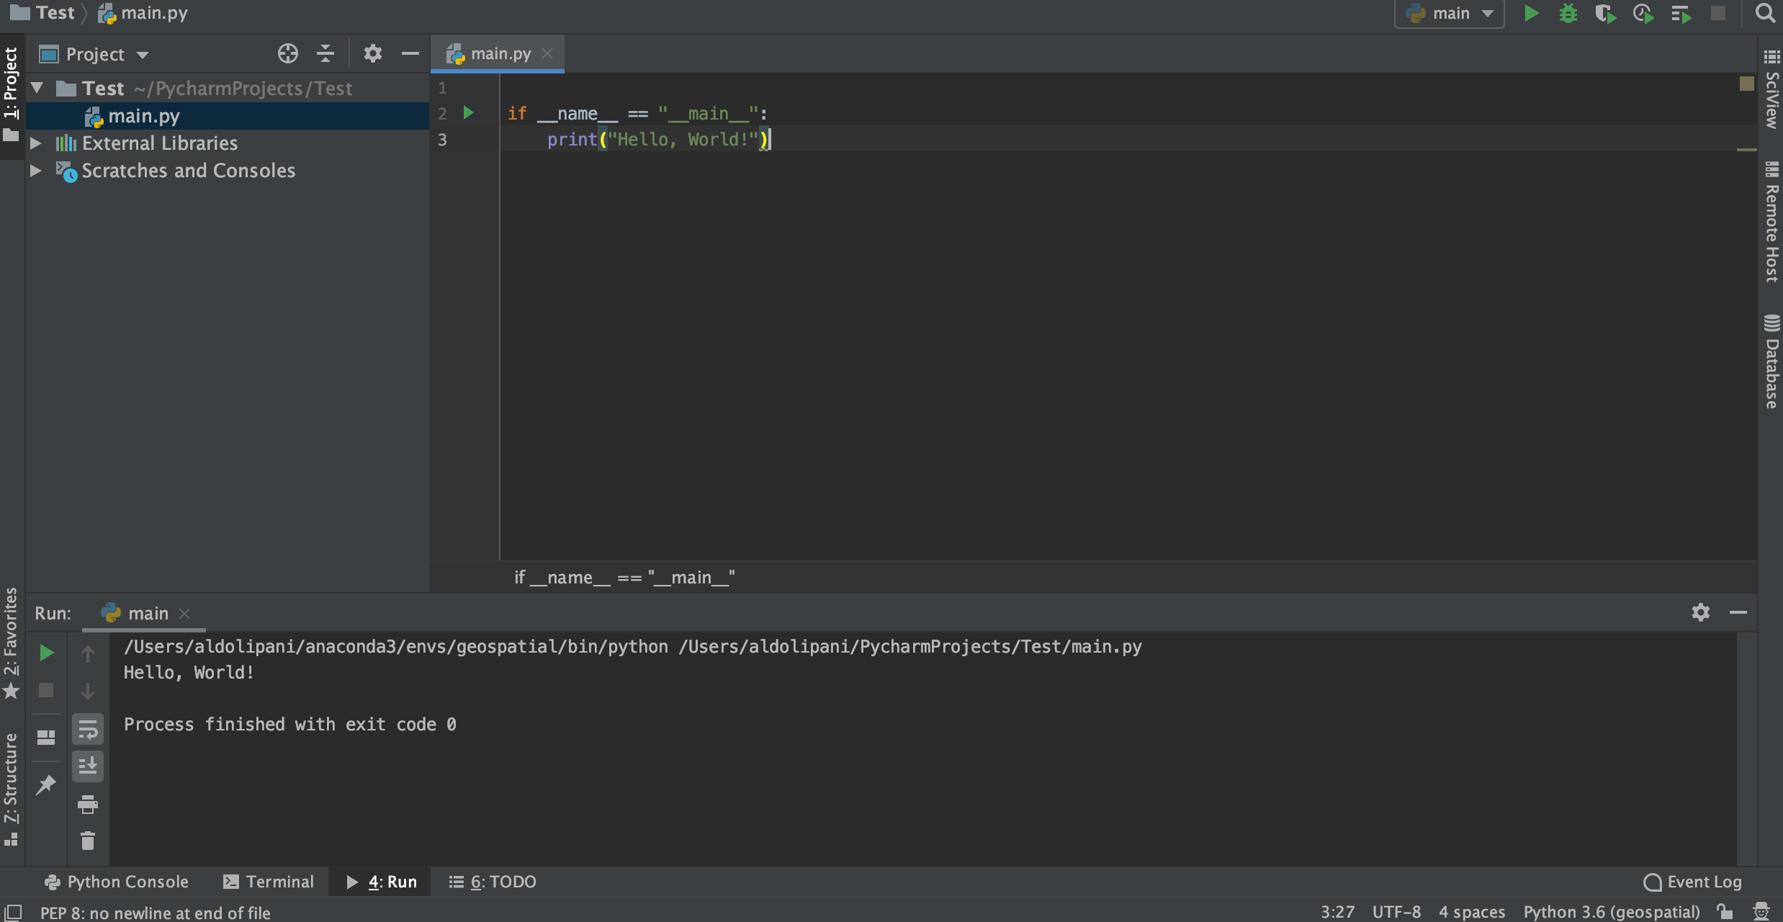
PyCharm
This will run the program and show the result in the Run Window below. Notice that the top-right dropdown menu is now configured to main, and the other buttons are activated.

Slide 39
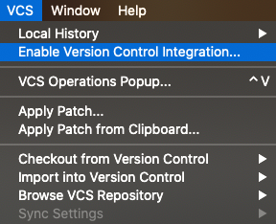
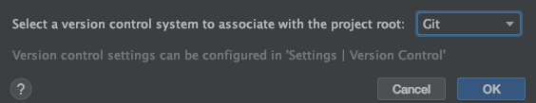
VCS in PyCharm
You first need to enable version control integration through the VCS menu:
Then, you need to select Git:
If Git was correctly installed in your machine, then these steps should be enough to make it work.

Slide 40
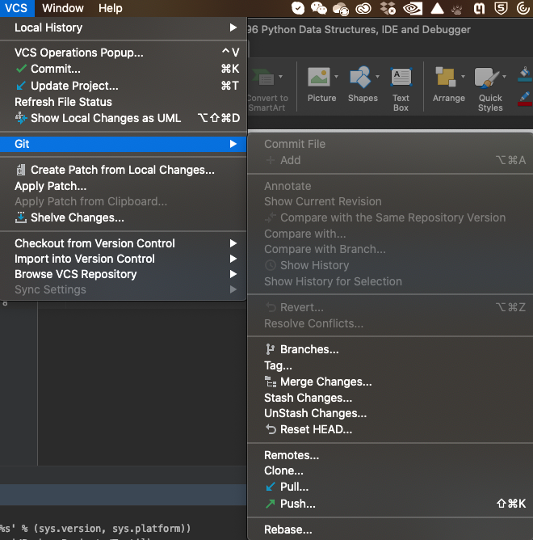
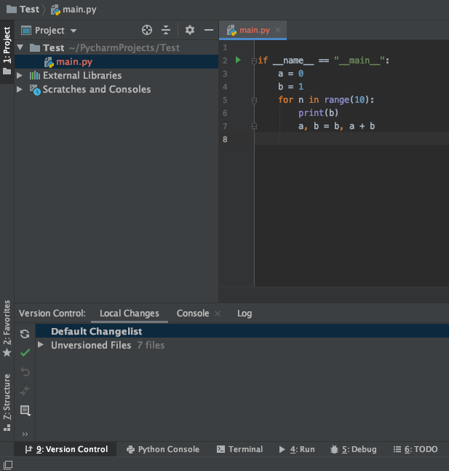
VCS in PyCharm
You should now have a new VCS menu and a new Tool Window, the Version Control Window.

Slide 41
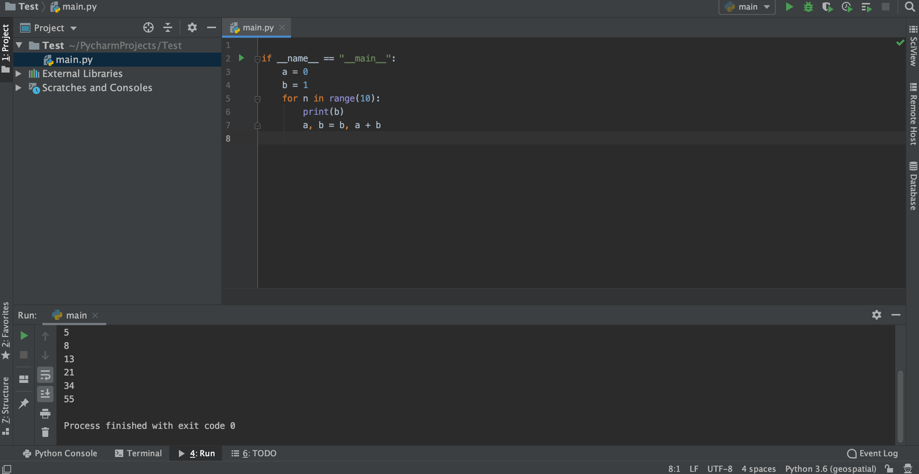
Debugging in PyCharm
The Fibonacci series

Slide 42
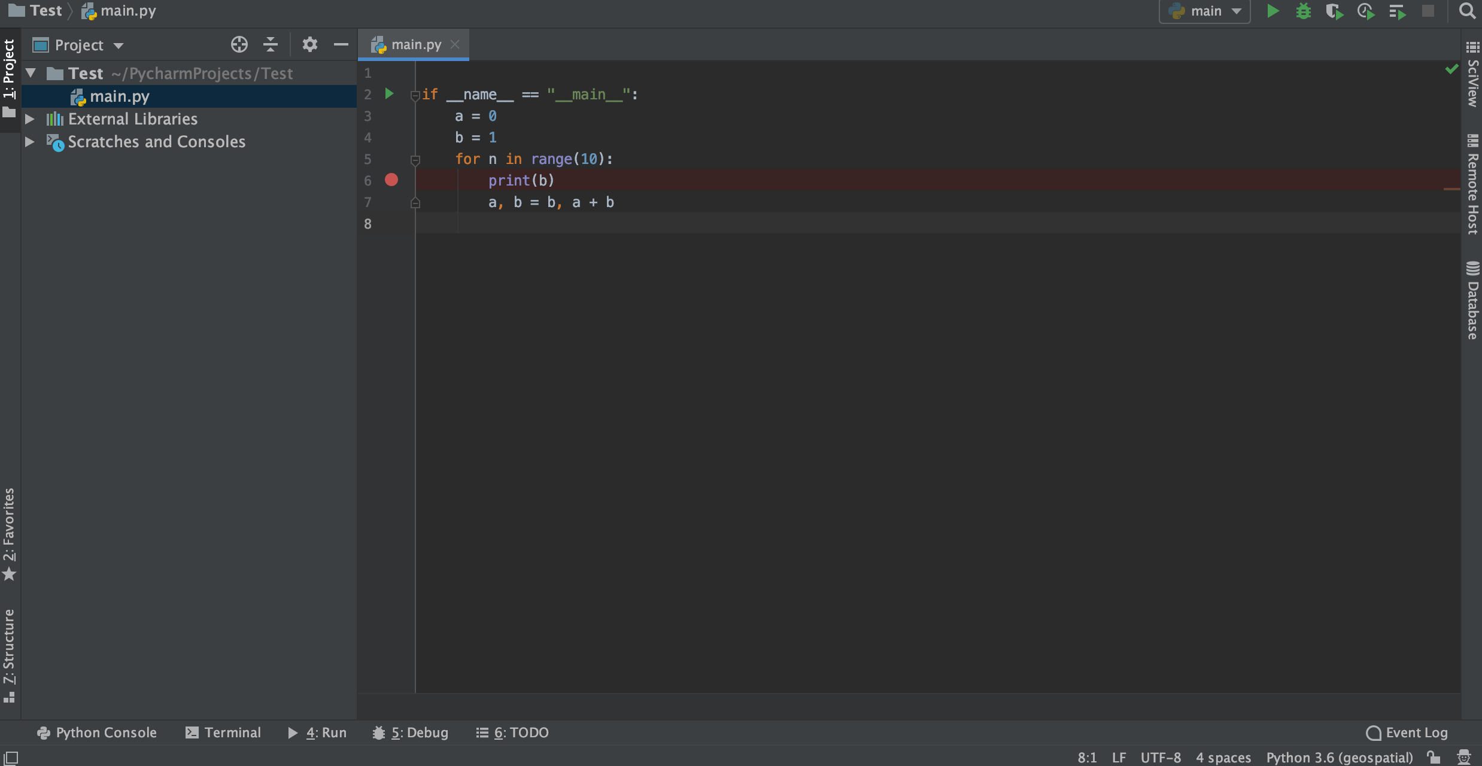
Debugging in PyCharm
Set a breakpoint wherever you want to stop the execution.

Slide 43
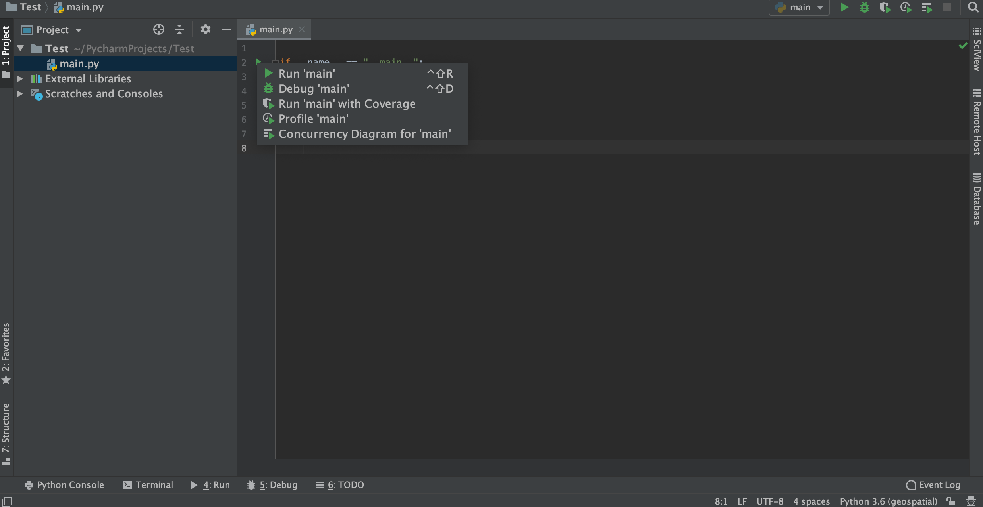
Debugging in PyCharm
Run the code in debug mode by clicking on the green bug icon (on the drop-down menu after clicking the green play button or directly from the top-right menu).

Slide 44
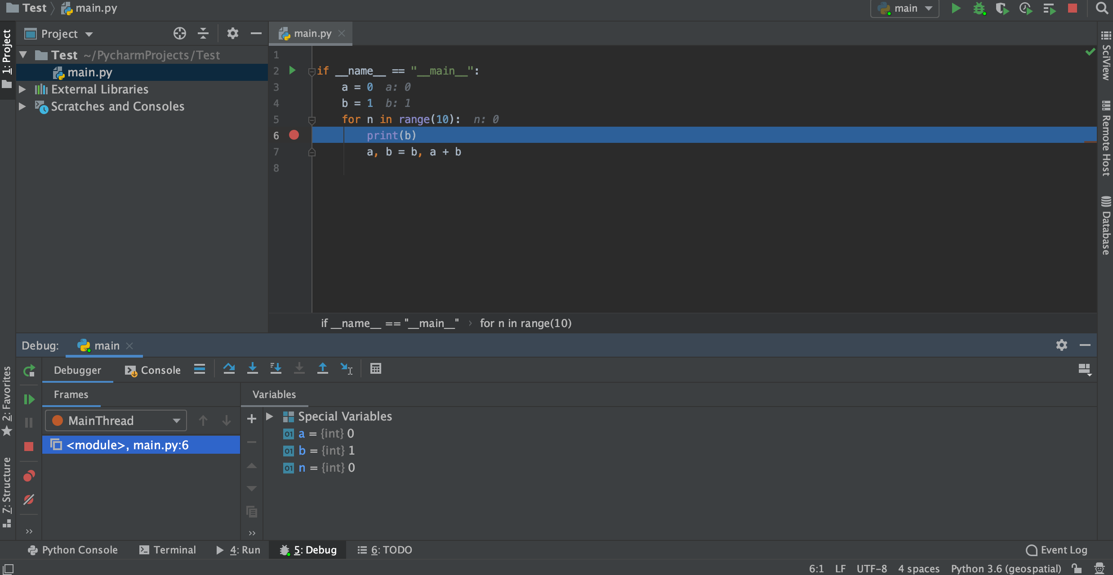
Debugging in PyCharm
You are now in debugging mode.
Line to be executed next!
To run to the next breakpoint
To step to the next instruction
State of the program

